Slide 1


Everway SDET
Shift-Left Program
August / September 2026

Slide 2

Session timings
Start and finish
13:00 – 17:00
Breaks
14:00 – 14:10
15.50 – 16:00

Slide 3

Housekeeping
Feel free to interrupt
the trainer at any
time - you don’t
need to
raise your
hand!
Keep your
camera on
Stay muted
but be ready
to regularly un-
mute and join in
Turn phones to silent, and close your email

Slide 4


Shift-Left Program
What we are going to cover in this program.
Phase 1 – Think like an SDET
Shift-left, quality ownership, Testing Pyramid, Playwright foundations.
API testing with Postman, AI-enabled testing, assessment.
Phase 2 – Engineer a quality solution
Playwright suites, AI in practice, Pact, JMeter.
  Build a broader automated testing strategy rather than simply automate UI tests.
Developer coaching, testability, exploratory testing.
  Operate as an embedded SDET who improves the team’s engineering practices.
Phase 3 - Hackathon
Coming Soon.

Slide 5
Phase 2 Day 3
Build Automation Suites in Playwright (Page Object Model, component testing)
AI in Practice
Contract Testing with PACT
Load Testing with JMeter

Slide 6
Engineering an Automation Strategy
Today's question: Can we maintain this automation six months from now?

Slide 7
Beyond “Can We Automate It?”
Which test level would expose a 9% battery rule fastest?
Why can a UI constraint differ from API protection?
What makes an automated check independent?
When should AI-generated code be trusted?
New question: What happens when three tests become three hundred?

Slide 8
Today's Outcomes
By the end, you can:
organise setup and fixtures around isolation;
judge whether a Page Object earns its cost;
diagnose likely sources of flakiness;
explain and sketch a consumer contract;
distinguish performance test types and interpret percentiles.

Slide 9
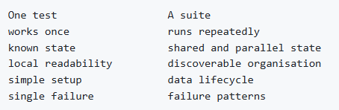
From Tests to a Suite
Watch for
duplication order dependence slow UI setup leaky abstractions.

Slide 10

Activity 1 — Review the Growing NeuroPulse Suite
Purpose
Identify maintainability, speed, data, and diagnostic risks in a suite design.
NeuroPulse context
Extend the starter Participants/navigation/session examples conceptually.
Estimated time: 15 minutes

Slide 11
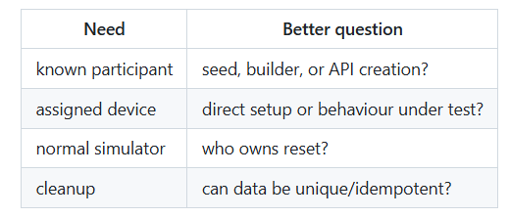
Setup Is Part of Test Design
Use the UI to test UI behaviour—not merely to transport setup.

Slide 12
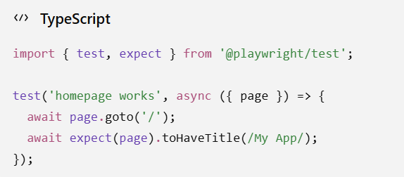
Playwright Fixtures: Reusable Context, Explicit Ownership
A Playwright fixture is a controlled piece of test setup that Playwright:
  creates for your test.
  gives to the test.
  and then cleans up afterwards.
Here, page is a fixture.

Slide 13
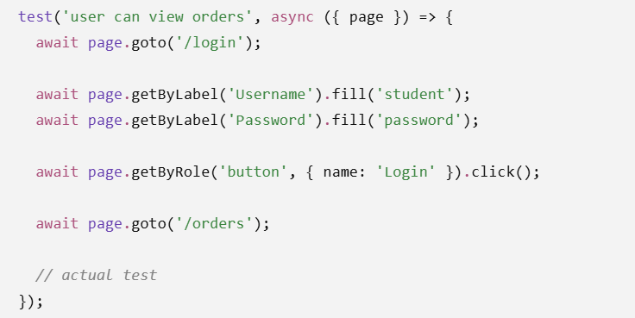
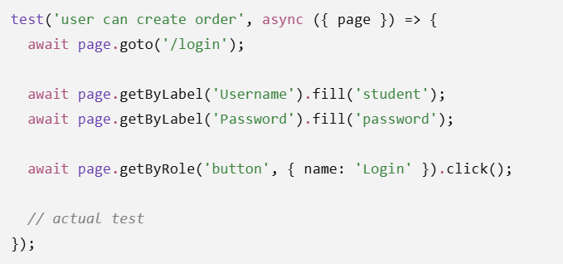
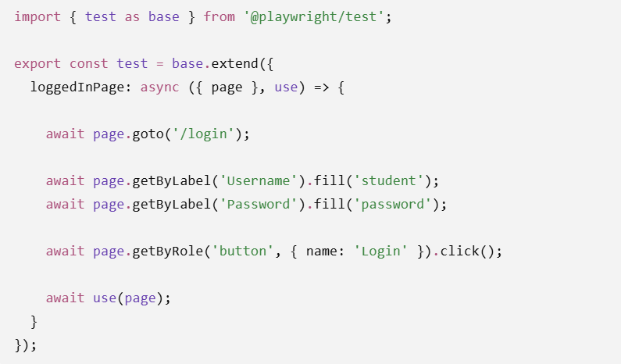
Reusable Setup
Test 1
Test 2
Fixture (loggedInPage)

Slide 14
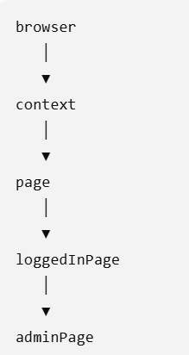
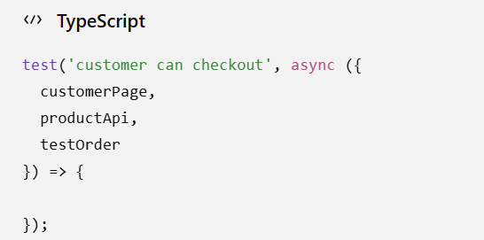
Dependency Injection for Playwright
Fixtures can themselves depend upon other fixtures

Slide 15
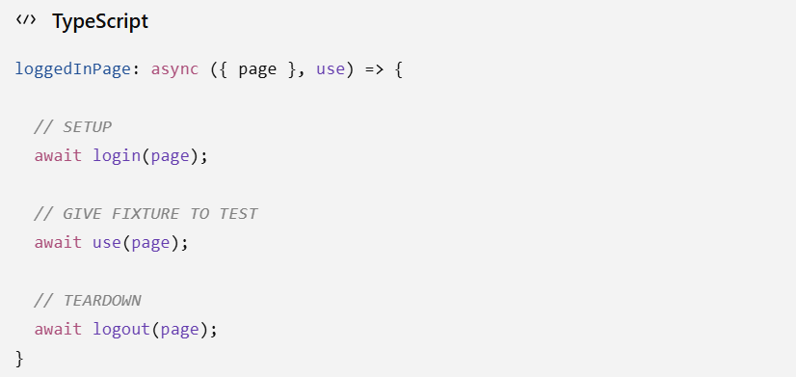
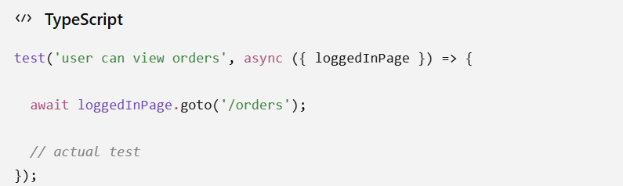
Fixture Structure

Slide 16
Activity 2 — Remove the Repeated Setup
Purpose
Refactor repeated UI preparation into an explicit, isolated setup strategy.
NeuroPulse context
Prepare participant/device/session state using fixtures and appropriate API calls.
Estimated time: 15 minutes

Slide 17
Page Objects: What Problem Are We Solving?
They can:
name stable user interactions;
centralise repeated locator knowledge;
reduce irrelevant detail in tests.
They can also:
become giant “god pages”;
hide assertions and control flow;
mirror the DOM instead of the domain.

Slide 18
Activity 3 — Should This Become a Page Object?
Purpose
Choose an abstraction based on change patterns and readability, not convention.
NeuroPulse context
Compare Participants filters, shared navigation, and the recording workflow.
Estimated time: 10 minutes

Slide 19

Flakiness Is a Symptom
Classify → reproduce → gather evidence → isolate → fix cause

Slide 20
Asynchronous Failure: Ask What Completed
Was the element actionable?
Did the request leave the browser?
Did the API complete or time out?
Did the simulator return V1, V2, or 503?
Did the UI render the newest state?
Did another test mutate shared data?
Wait for an observable condition; never wait “just in case.”

Slide 21
Activity 4 — Find the Source of the Flake
Purpose
Classify intermittent failure and propose evidence that distinguishes causes.
NeuroPulse context
Use latency, unreliable-device controls, parallel state, or the starter fixed wait.
Estimated time: 15 minutes

Slide 22
AI as Pair Tester—not Autopilot
Provide bounded evidence:
Ask for:
ranked hypotheses;
evidence for/against each;
next diagnostic action;
smallest safe refactor.

Slide 23
Activity 5 — AI as Pair Tester
Purpose
Use AI to analyse evidence or duplication while retaining engineering judgement.
NeuroPulse context
Review a failure trace, fixed wait, or repeated suite setup.
Estimated time: 10 minutes

Slide 24
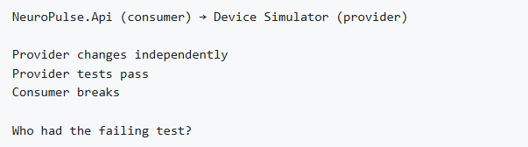
The Contract Problem

Slide 25
Consumer Contract + Provider Verification
A useful contract captures what the consumer actually depends on—no more.

Slide 26
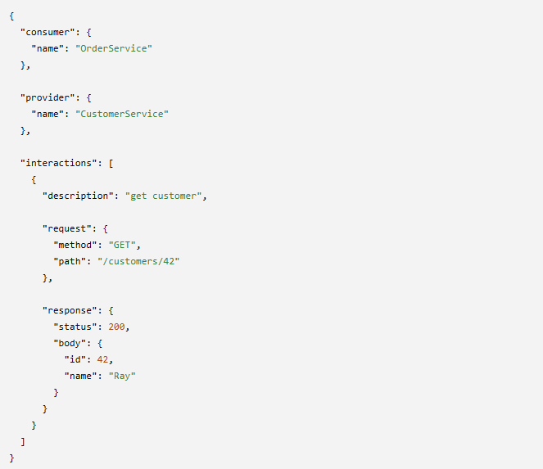
PACT JSON Format
Usually, though, developers don't hand-write these JSON files. They use a Pact library in their language, and the tests generate the Pact.
Consumer test
PACT library
customer-order.json

Slide 27
PACT Broker
PACT Broker
Contracts
Consumer A to B
Consumer C to B
Consumer D to E
Consumer
Provider
Runs tests
Generates PACT
Downloads PACT
Verifies contract

Slide 28
Activity 6 — What Does NeuroPulse Actually Depend On?
Purpose
Identify the smallest meaningful consumer expectation at a service boundary.
NeuroPulse context
Model the API consumer's V1 device-status interaction with the simulator.
Estimated time: 10 minutes

Slide 29
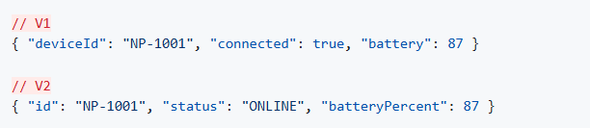
V1 → V2: Compatible or Breaking?
Provider correctness does not imply consumer compatibility.

Slide 30
Activity 7 — Catch the Breaking Change
Purpose
Predict and expose an independently introduced contract incompatibility.
NeuroPulse context
Compare simulator V1 with the Contract Breaking Change scenario (V2).
Estimated time: 10 minutes

Slide 31
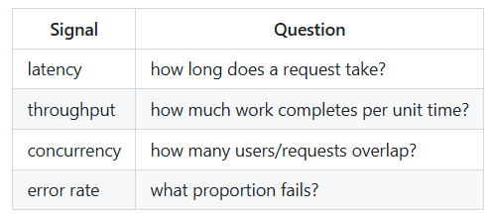
Functional Correctness Is Not Enough
A target needs workload + environment + threshold + duration.

Slide 32
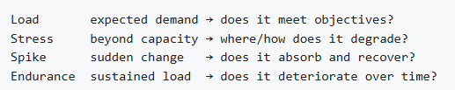
Load, Stress, Spike, Endurance
Choose the test that answers the risk question.

Slide 33
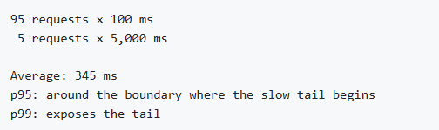
Why the Average Can Lie
Percentile: X% of observations completed at or below this value.

Slide 34
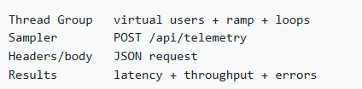
JMeter: Small Mental Model
The scaffold starts safely: 1 user × 5 iterations.

Slide 35
Activity 8 — How Does NeuroPulse Behave Under Load?
Purpose
Compare a safe baseline with changed load or simulator conditions and interpret signals.
NeuroPulse context
Use the telemetry JMeter plan and Performance Stress scenario.
Estimated time: 15 minutes

Slide 36
Day 3 Strategy Check
Does suite structure preserve intent and isolation?
Is abstraction paying for itself?
Did we diagnose rather than retry the flake?
Does a contract protect the real dependency?
Does performance evidence answer a stated risk?

Slide 37
Thank you

